Slide 1

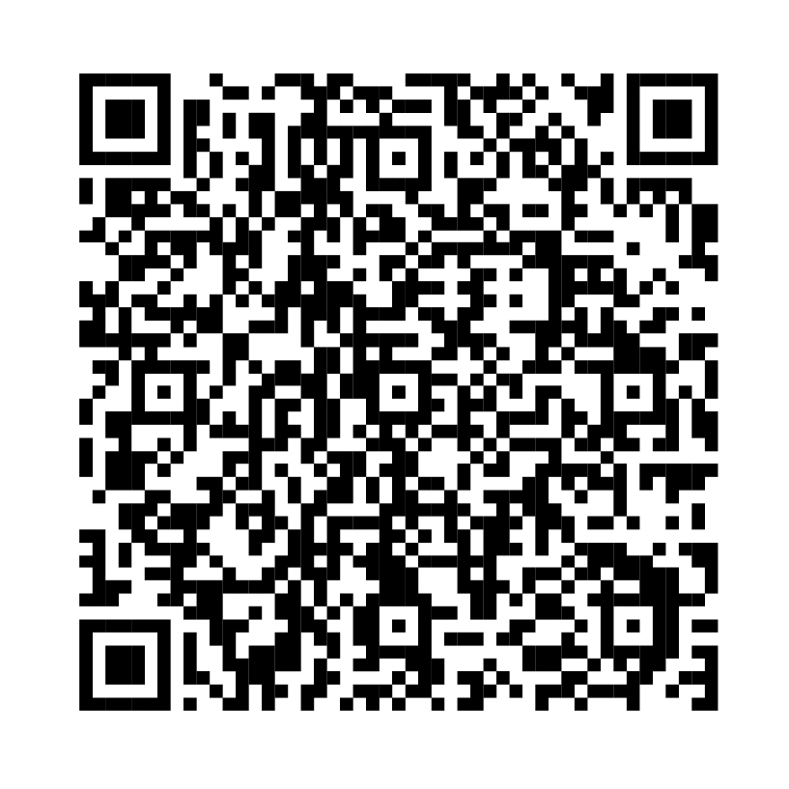
In honor of Veterans
Appreciation Month
Register for two live web workshops
focused on the financial needs of
the military community.
Scan the code to register or
visit Fidelity.com/military
Investing involves risk, including risk of loss.
The Fidelity Investments logo is a registered service mark of FMR LLC.
Fidelity Brokerage Services LLC, Member NYSE, SIPC, 900 Salem Street, Smithfield, RI 02917
© 2026 FMR LLC. All rights reserved. 1267704.1.0

